Slide 1
AI CODE REVIEWER
Input Code -> AI:
Identifies language
Detects errors
Highlights warnings
Suggests improvements
Rates the code

Slide 2
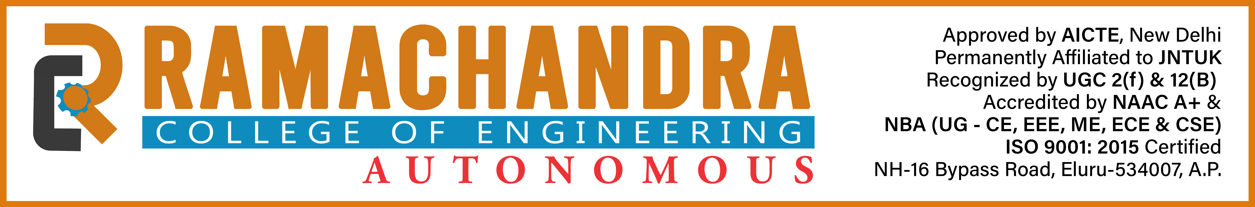
Mentor: Dr./Prof./Mr. Pavan Kumar
PROJECT TEAM MEMBERS:
    24ME1A5491 Sravani. P
    24ME1A5479 Thanushka. N
    24ME1A5494 Bhaavya sri. P
    24ME1A5484 Sravya Sruthi .P

Slide 3
CONTENTS:
Introduction
• Problem Statement
• Objectives
• Innovation & Uniqueness
• Proposed Methodology
• Technologies Used
• System Workflow
• Key Features
• Expected Outcomes
• Work Plan / Timeline
• Conclusion

Slide 4

Problem Statement:
Many students and beginners face difficulties in identifying errors in their code and understanding proper programming practices. Traditional methods of code review require guidance from experienced programmers, which is not always available. As a result, students struggle to debug their code, improve logic, and learn effectively. Therefore, there is a need for a simple and intelligent system that can automatically analyze code, detect errors, and provide useful suggestions in real-time.

Slide 5
Objectives:
To develop an AI-based system for analyzing programming code.
To detect errors and provide accurate feedback to users.
To help students understand coding mistakes easily.
To provide useful suggestions for improving code quality.
To support multiple programming languages.
To create a simple and user-friendly interface using Streamlit.
To enable quick and efficient code review without external compilers.

Slide 6
Innovation and Uniqueness:
Integrates AI-based code analysis for intelligent feedback.
Works without external compilers, making it lightweight and easy to use.
Provides instant feedback including errors, warnings, and suggestions.
Supports multiple programming languages in a single platform.
Offers different analysis levels (Quick, Standard, Deep) for flexibility.
Features a simple and user-friendly interface using Streamlit.
Includes Dark/Light mode for better user experience.

Slide 7
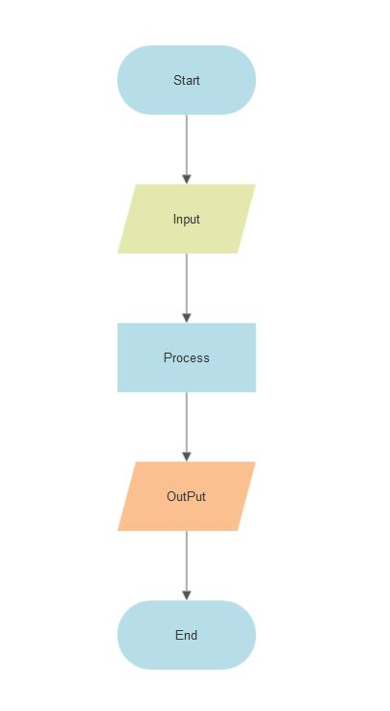
Proposed Methodology:
User enters code
Selects language & depth
Code sent to AI model
AI analyzes code
Errors & suggestions generated
Results displayed

Slide 8
Expected Outcomes:
The system will successfully analyze user code.
It will detect syntax errors and issues in the code.
It will provide clear and useful suggestions for improvement.
The application will generate an overall rating for the code quality.
Users will be able to understand mistakes easily.
It will help students improve their coding skills.
The system will deliver quick and efficient results.

Slide 9
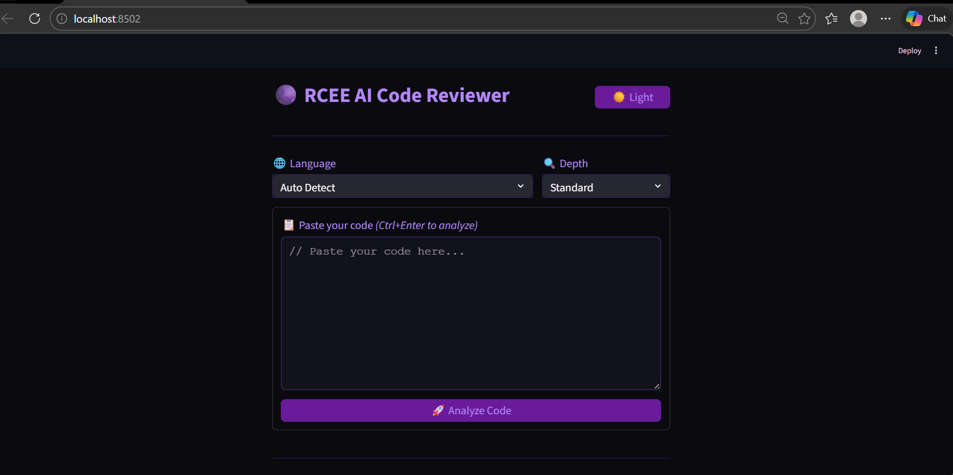

Slide 10
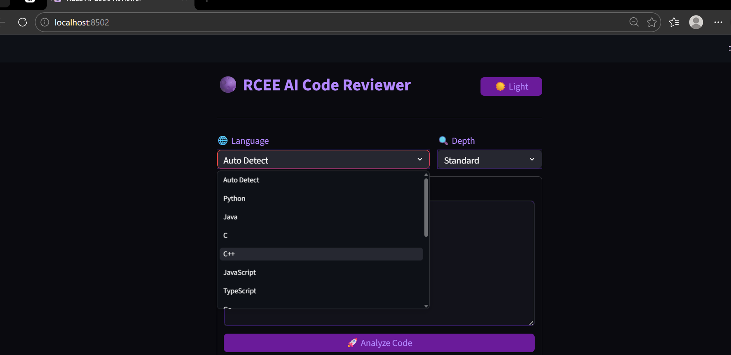

Slide 11
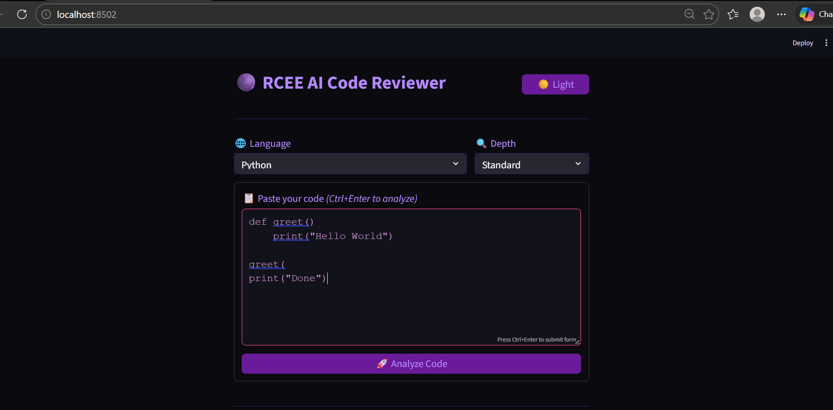

Slide 12
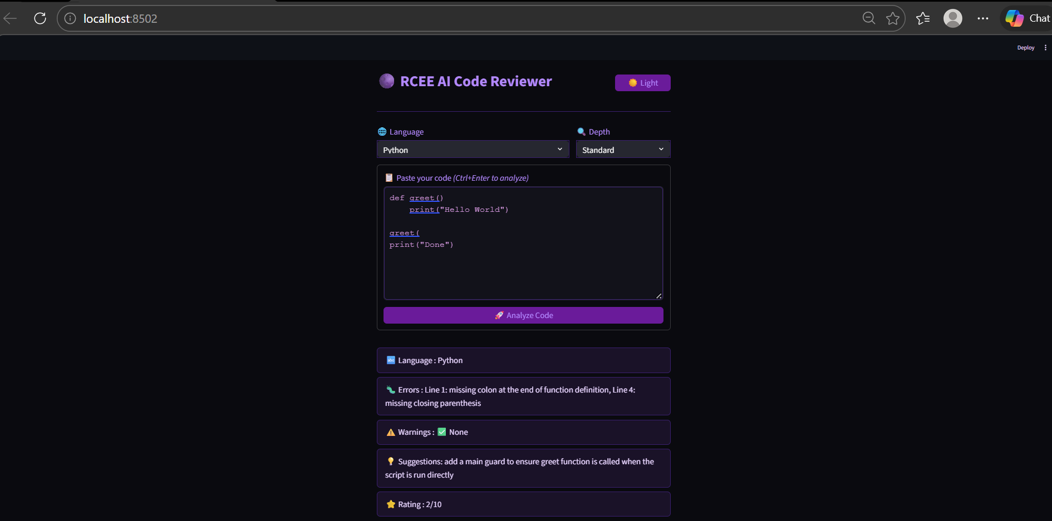

Slide 13
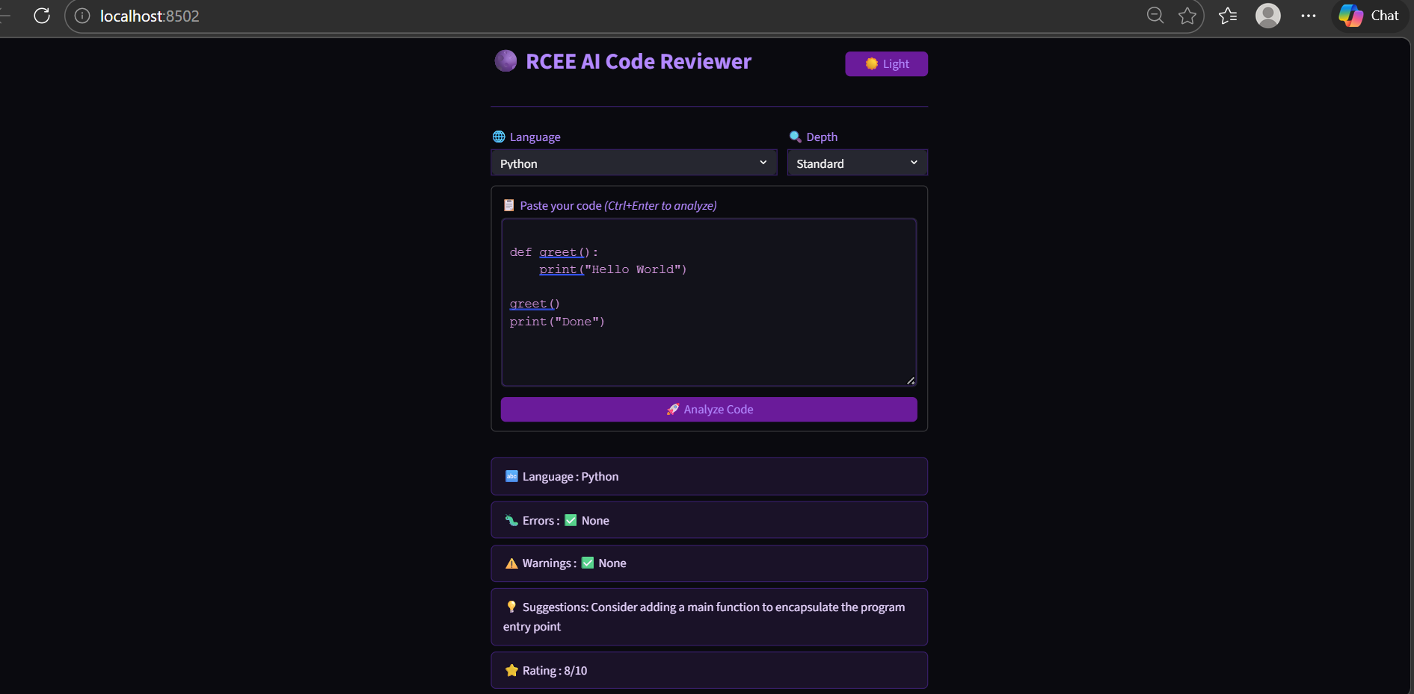

Slide 14
Work Plan / Timeline:
Week 1: Requirement analysis and project planning
Week 2: Designing the system and UI layout
Week 3: Developing the Streamlit interface
Week 4: Integrating AI model (Groq API)
Week 5: Implementing code analysis features
Week 6: Testing and debugging the application
Week 7: Final modifications and improvements
Week 8: Documentation and PPT preparation

Slide 15

Conclusion:
The AI Code Reviewer is a simple and effective tool for code analysis.
It helps users detect errors and improve code quality.
The system provides instant feedback, suggestions, and rating.
It is easy to use and does not require complex setup.
The project enhances learning and coding skills of students.
It can be further improved with advanced AI features in the future.

Slide 16
Thank You

